Slide 1
Welcome!
Sunday
Bible Study 9:30 AM
Worship 10:30 AM
Wednesday
Bible Class 7:00 PM
www.SunsetchurchofChrist.net

Slide 2
John 8:21-30
Jesus reveals His goal
Belief in Jesus
Speaking from the Father

Slide 3
Welcome!
Sunday
Bible Study 9:30 AM
Worship 10:30 AM
Wednesday
Bible Class 7:00 PM
www.SunsetchurchofChrist.net

Slide 4
Opening Prayer | Lamar McDonald
Song – | George Watkins
Scripture Reading | Michael Hetzer
Song – | George Watkins
Song – | George Watkins
Lord’s Supper | Michael Hetzer / Tacho Montanez
Song – | George Watkins
Collection | Michael Hetzer / Tacho Montanez
Song – | George Watkins
Lesson | Brian Haines
Song – | George Watkins
Closing | Anthony Ward

Slide 5
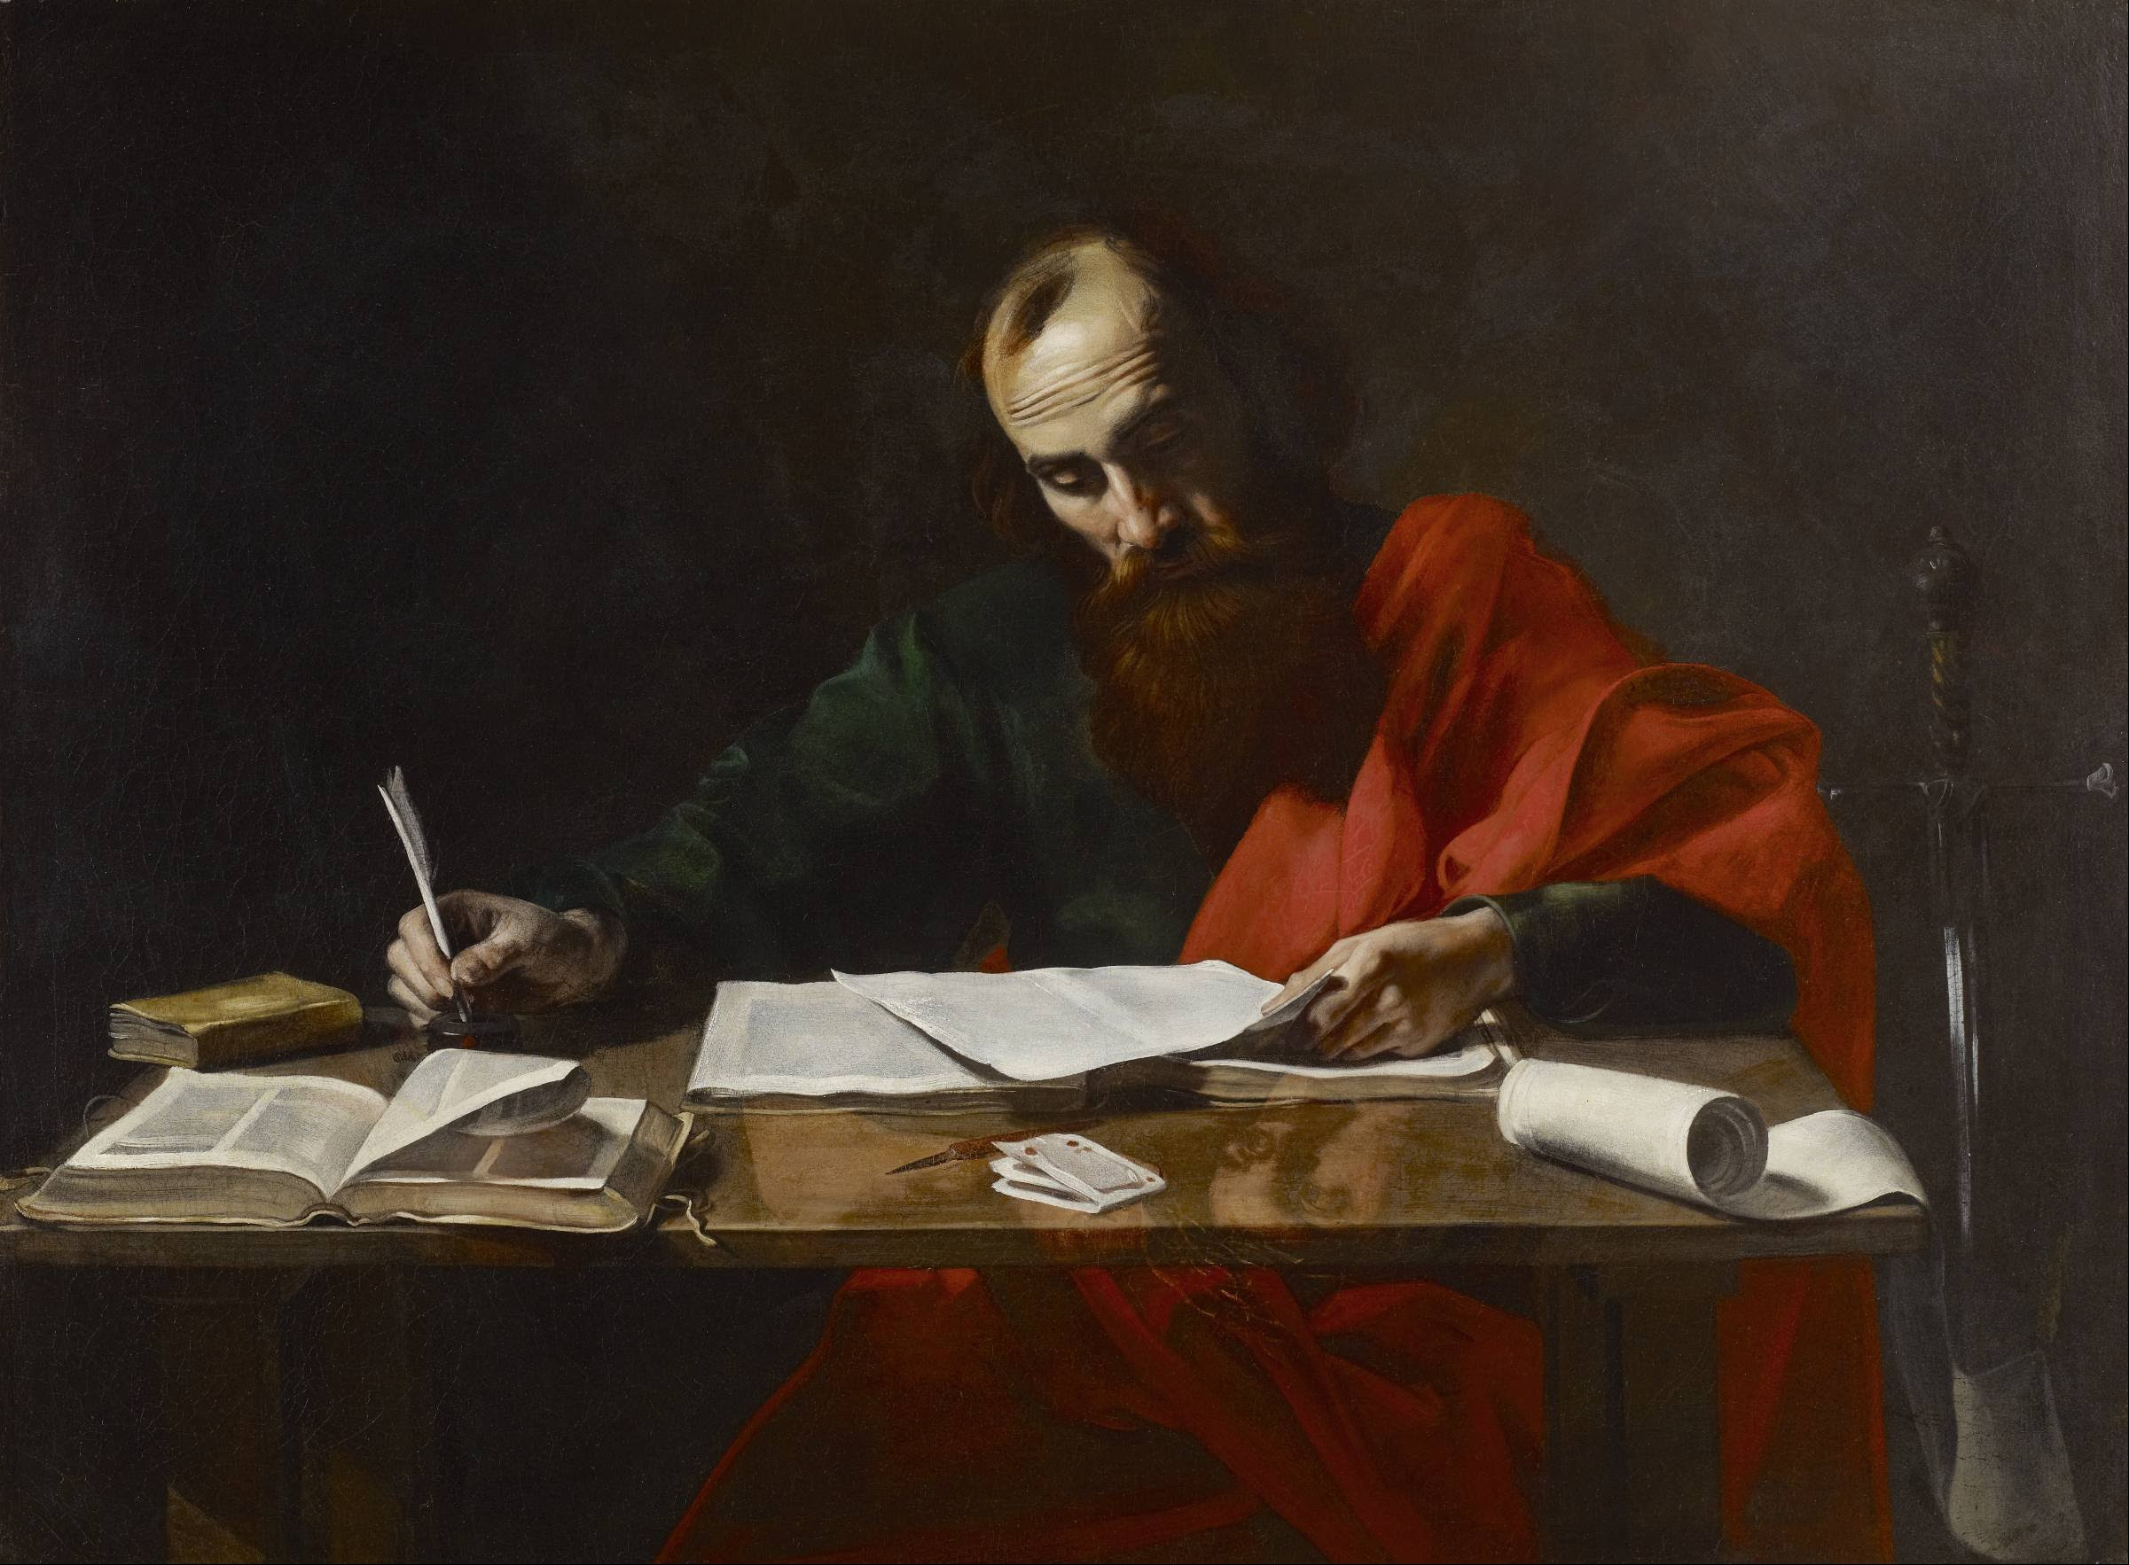
Paul’s Corinthian Advice
1 Corinthians 7
Marriage

Slide 6
1 Corinthians 7 and Marriage
God desires for men and women to marry
Genesis 2:18 – It is not good alone
1 Timothy 3:1-13 – to serve God
1 Corinthians 7:2 – to avoid fornication
We need to teach the pursuit of marriage
Notes:
Ge 2:18 ¶ And the LORD God said, "It is not good that man should be alone; I will make him a helper comparable to him."

Slide 7
1 Corinthians 7 and Marriage
God desires for men and women to marry
God desires marital intimacy
To avoid sin
To strengthen marital relationship
Spiritual significance of intimacy
We need to teach self-control
Notes:
Ge 2:18 ¶ And the LORD God said, "It is not good that man should be alone; I will make him a helper comparable to him."

Slide 8
1 Corinthians 7 and Marriage
God desires for men and women to marry
God desires marital intimacy
God insists on sexual purity
In marriage and out of it
We need to teach the place of intimacy
Notes:
Ge 2:18 ¶ And the LORD God said, "It is not good that man should be alone; I will make him a helper comparable to him."

Slide 9
1 Corinthians 7 and Marriage
God’s rule on divorce: DON’T
"Whoever divorces his wife and marries another commits adultery; and whoever marries her who is divorced from her husband commits adultery” Luke 16:18
Notes:
Ge 2:18 ¶ And the LORD God said, "It is not good that man should be alone; I will make him a helper comparable to him."

Slide 10
1 Corinthians 7 and Marriage
God’s rule on divorce: DON’T
If one does divorce:
“Remain unmarried or be reconciled”
Notes:
Ge 2:18 ¶ And the LORD God said, "It is not good that man should be alone; I will make him a helper comparable to him."

Slide 11
1 Corinthians 7 and Marriage
God’s rule on divorce: DON’T
If one does divorce: unmarried or reconcile
Exceptions?
Matthew 19 – fornication
Exception(s) to the exception
Matthew 6 - forgiveness
Notes:
Mt 19:9 "And I say to you, whoever divorces his wife, except for fornication, and marries another, commits adultery; and whoever marries her who is divorced commits adultery."

Slide 12
1 Corinthians 7 and Marriage
God’s rule on divorce: DON’T
If one does divorce: unmarried or reconcile
Exception – Matthew 19
When a (unbelieving) spouse departs:
Not under bondage to (follow) them
Sanctification of the marriage
Notes:
Ge 2:18 ¶ And the LORD God said, "It is not good that man should be alone; I will make him a helper comparable to him."

Slide 13
1 Corinthians 7 and Marriage
What God wants us to understand
Marriage is a “work prepared” by God
Sometimes marriage is not a good thing
When we are not to marry
Circumstances in our lives (vs. 26)
Dispositions and attitudes are wrong

Slide 15
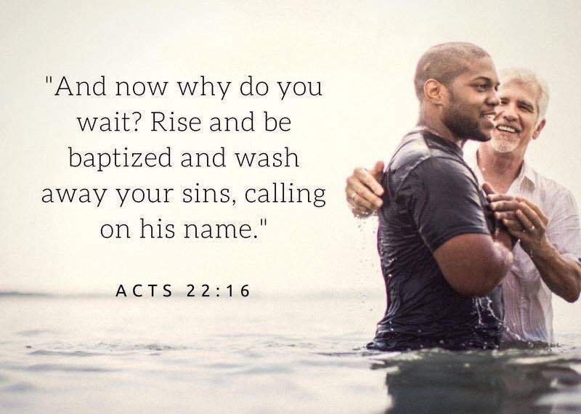
Obedience to the Gospel

